Slide 1
ASL – My school-work experience
Francesco Milani
5AI
a.s. 2019/2020

Slide 2

What i thought before work
When the school communicate to me that the company I was been assignated was a hardware company, I started thinking about the job I was going to do.
I thinked that i was going to be a hardware technician, that is to act directly on the pc’s hardware, repairing and replacing the broke components, programming and installing them into the computer.
I also thinked that i was going to learn something that at school you usually don’t learn, how the hardware works, how to repair some components, how to replace them into the pc and also how to build an electronic board and how to program it.

Slide 3

The company
The company that i was assigned was the DuoLabs Srl, a small company in Bassano Del Grappa. I was assigned with my classmate Francesco Rigoni.
This company deals with PCB design, device related PC application, DVB Broadcasting, Home and industrial control devices and IOT.
The company stands in Via Baggi 28, that is the Legal office and there’s also a operative office in Cartigliano, but i’ve never visit it. The Legal office is composed by 6 person, which is a hardware technician, three programmer, a secretary and the boss.
The boss’s name is Riccardo Alessi. He was also my tutor during my working period.

Slide 4

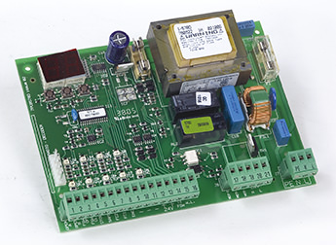
What i do
At first there have been three days where i watched the programmer of the company to understand what they do.
After this was assigned to me a Pc workstation, where i begin to program in Qt, that is a widget toolkit for creating graphical user interfaces.
On Qt I initially learn how to use thread and after I sperimented the serial communication with an electronic board.
In addition to programming I have to do the inventory of all the electronic hardware that was in the office’s cabinet.
On the last days of work the hardware technician assigned me the job of assembling pieces for the electronic boards.

Slide 5

What i thought after work
During my working period i could actually see and test a work reality that i could arrive at the end of my school education.
My personal opinion is that in future i won’t do a job like this, for various reason.
First of all i was totally inadapted for the programmation not assisted by professors, in fact I struggled a lot to understand the mechanisms indipendently and I was always bored when i have to start programming.
Whereas i appreciate the job where i have to do the inventory and when i have to assemble components. I think that in future i will do some manual work, because I felt more confident and I find the work more intresting.

